Slide 1

Fake News Detection System
Using Machine Learning

Slide 2
About us
NAME | DIPTESH CHAUDHARY ,KALPESH CHAUDHARY
ENROLLMENT NO. | 23082701008,23082701009
GROUP NO. | 6
GROUP MENTOR | HEMANI PATEL
COURSE NAME | BSC IT(DATA SCIENCE) – 5TH SEM
DEPARTMENT NAME | DEPARTMENT OF COMPUTER SCIENCE
UNIVERSITY NAME | GANPAT UNIVERSITY
ACADEMIC YEAR | 2025 - 26

Slide 3


What is Fake News?
False or misleading information that is reported as news is called fake news.
A common goal of fake news is to harm someone or something’s reputation or to profit through advertising.

Slide 4


Fake news in digital era!
With the rise of digital media, detecting fake News has become critical to prevent misinformation
This project aims to build a system that can Classify news articles as REAL or FAKE using Machine Learning and Natuaral Language Processing.

Slide 5


Problem Statement
Misinformation spreads rapidly online and can influence public opinion.
Manual detection is time-consuming and prone to human error.

Slide 6

Develop an ML-based system to detect fake news.
Utilize NLP techniques to analyze and process text data.
Integrate BeautifulSoup to scrape and classify real-time news.
Evaluate model performance using standard metrics.

Slide 7

Covers detection of fake news in English text articles.
Uses pre-labeled datasets and live scraped headlines.
Does not verify authenticity of news sources manually.
Can be extended for multilingual detection in future.

Slide 8
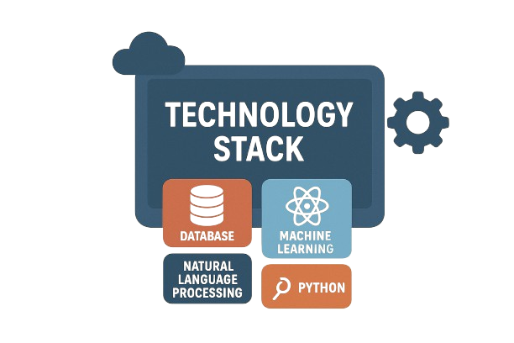
Technology Stack
Platform : windows 11
Programming Language : Python
Libraries: pandas, NumPy, matplotlib, seaborn,scikit-learn, nltk,
Development Environment: Jupyter Notebook / Google Colab ,Excel
Data Source: Kaggle Fake News Dataset
Optional Deployment: Streamlit

Slide 9
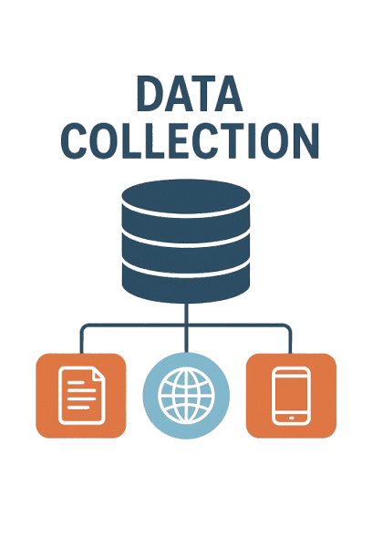
Data Collection
Primary dataset from Kaggle: Fake and Real News Dataset.
Web scraping using BeautifulSoup for real-time headlines.
Data stored in CSV format for preprocessing and modeling.

Slide 10
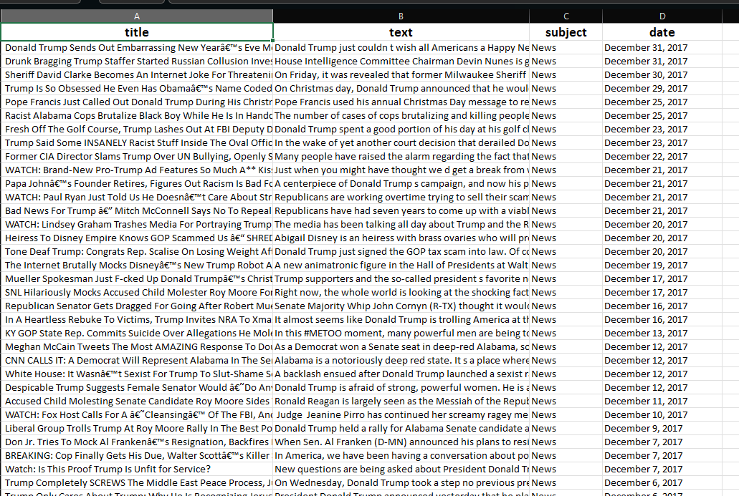
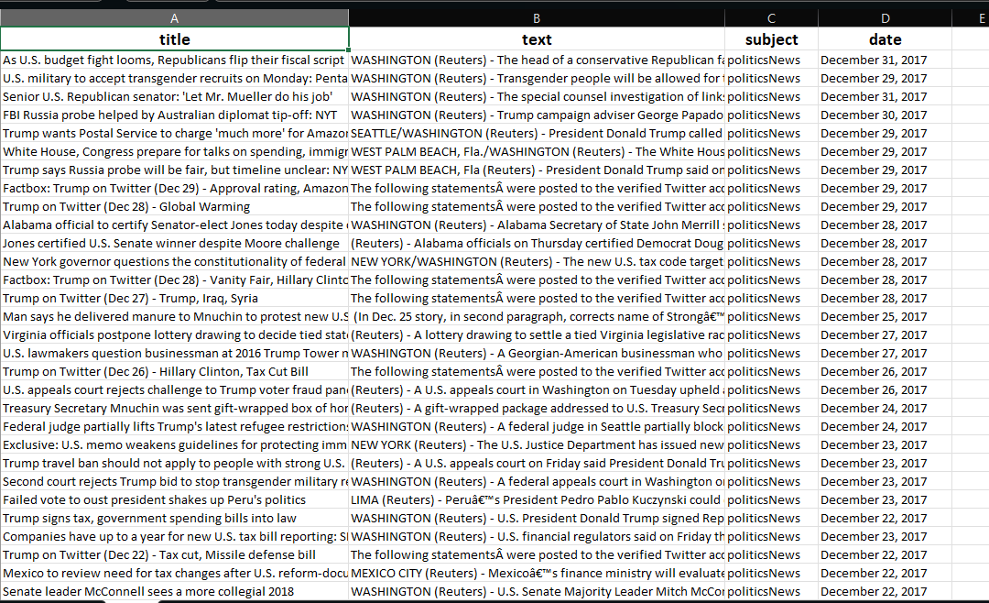
Data collection
Colums :
Title : (Headline of the News)
Text : (news texts)
Subject : (like PoliticsNews, WorldNews etc)
Date : (date when news published)

Slide 11




Data collection

Slide 12
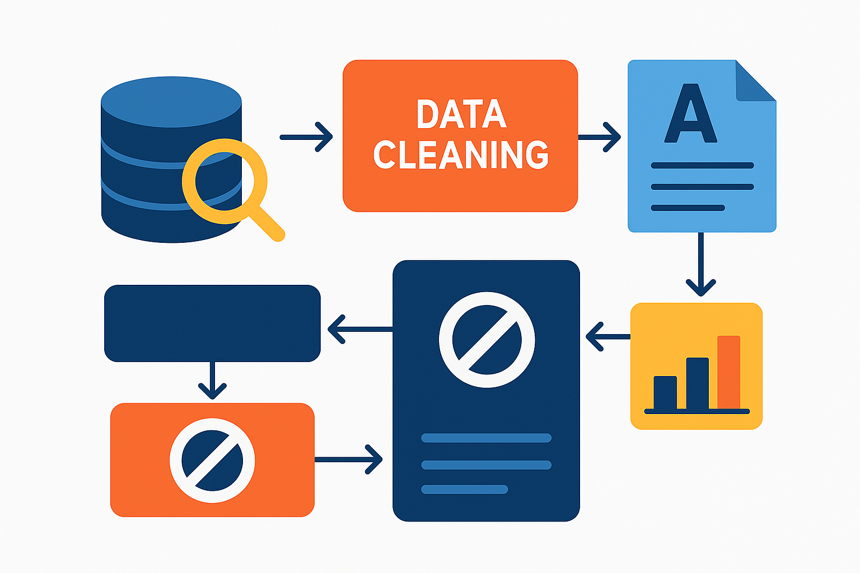
Data processing
Data Cleaning Remove unwanted characters, punctuation, numbers, and missing values.
Text Normalization Convert all words to lowercase for consistency.
Tokenization Split sentences into individual words (tokens).
Stopword Removal Remove common words like “the”, “is”, “and” that don’t add meaning.
Lemmatization / Stemming Reduce words to their base form (e.g., running → run).
Feature Extraction Convert processed text into numerical features using TF-IDF.

Slide 13
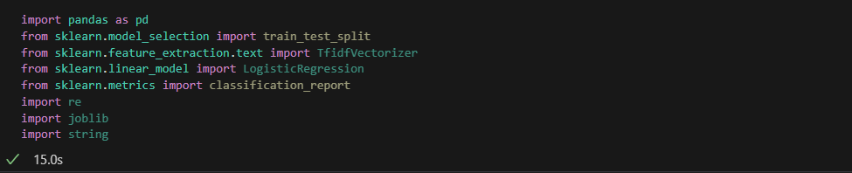
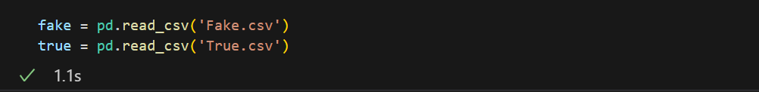
Importing libraries
Importing the File

Slide 14
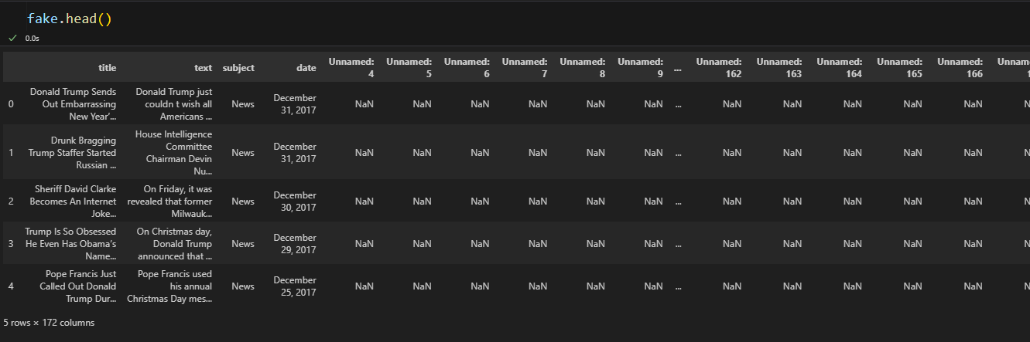
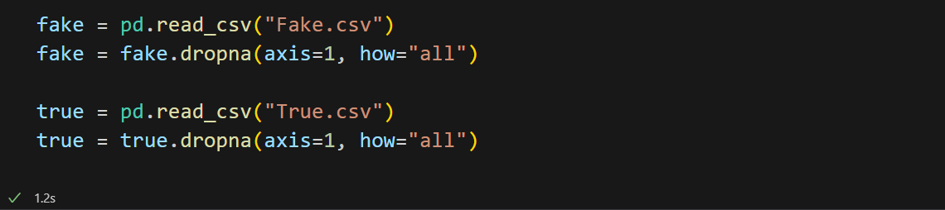
Before :
Dropping all unwanted unnamed column which are created because of
commas and special characters in the data

Slide 15
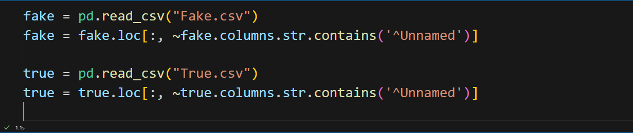
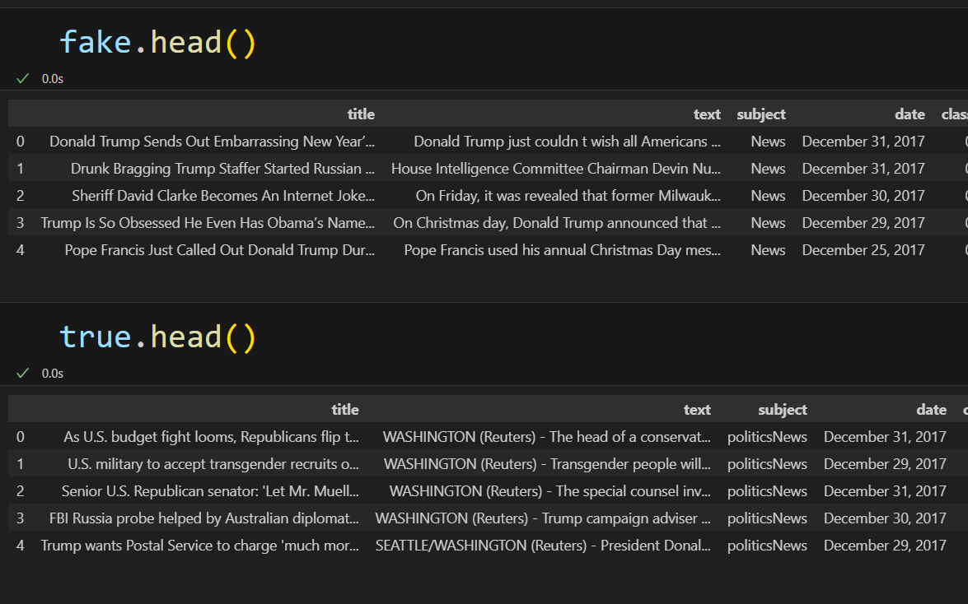
After:

Slide 16
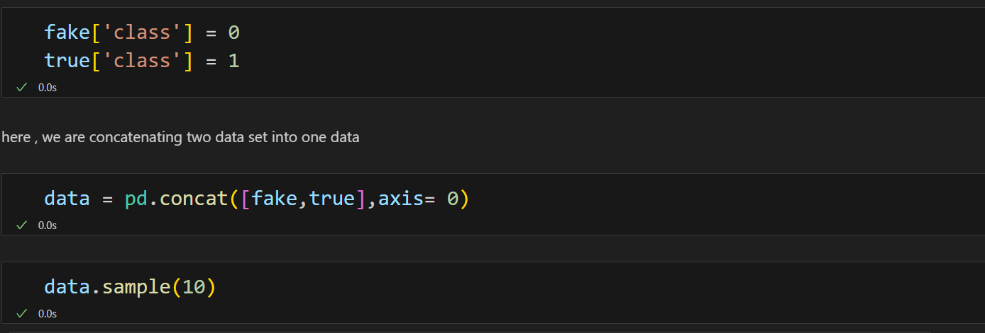
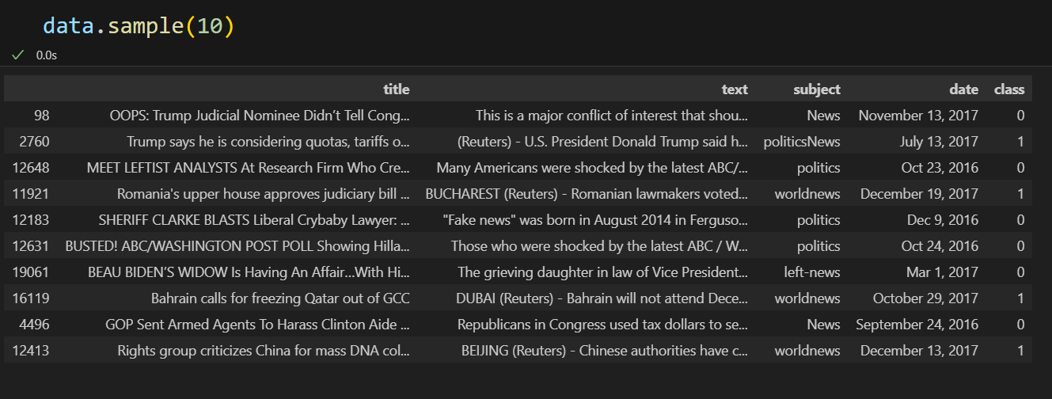
Concatinating two data’s into one

Slide 17
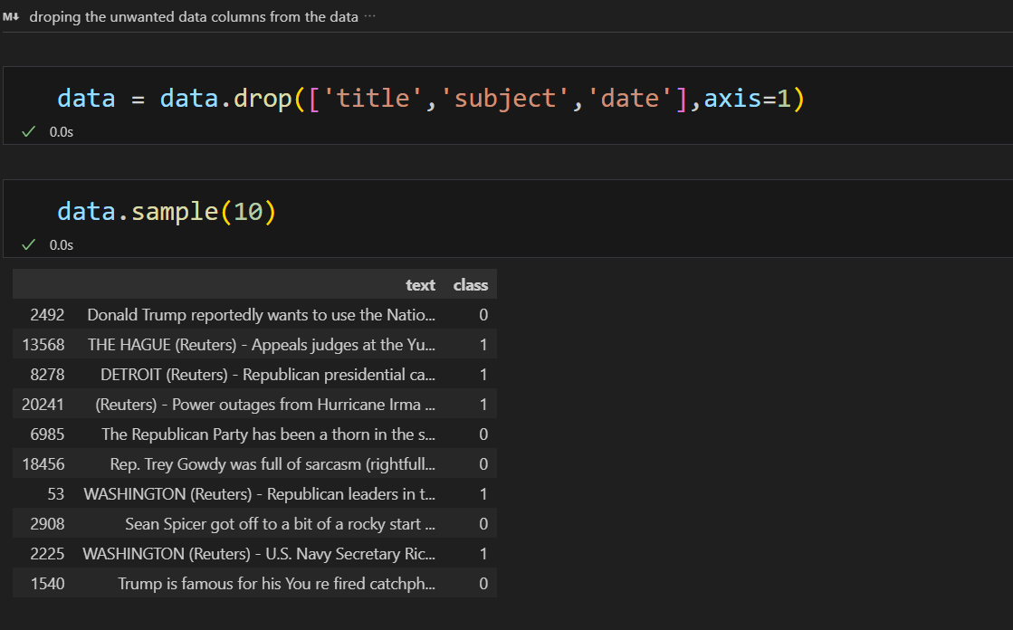
droping the unwanted data columns from the data

Slide 18
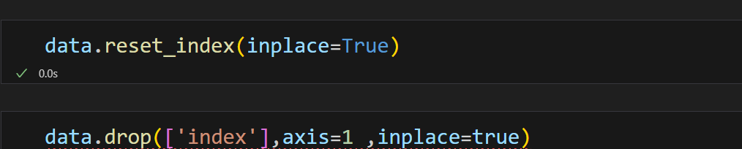
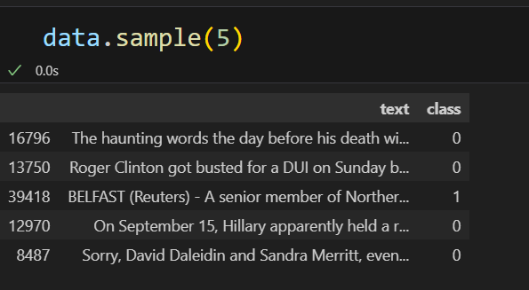

Slide 19

Text cleaning
Text cleaning is the process of preparing raw text data so it can be used for analysis or machine learning. It removes unwanted parts of text and keeps only the useful information.
Convert all text to lowercase → "Apple" and "apple" become the same.
Remove punctuation, symbols, and special characters.
Remove URLs, HTML tags, or extra spaces.
Remove numbers if not needed.
Remove stopwords (like "is", "the", "and") that don’t add meaning.
Perform stemming/lemmatization (reduce words to their base form, e.g., playing → play).

Slide 20
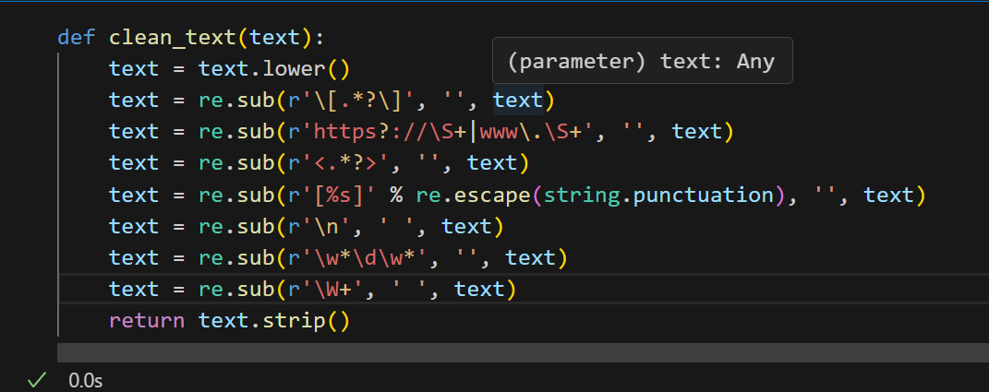
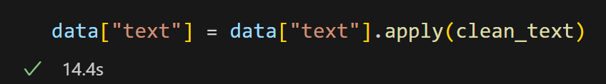
Function that perform text cleaning
Applying the Function to the text column

Slide 21
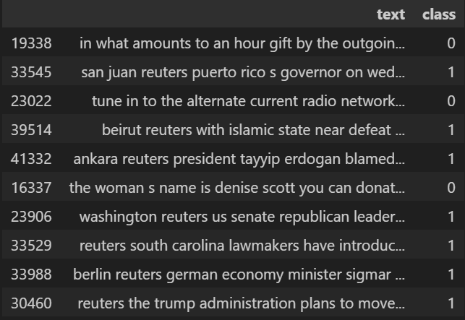
After text Cleaning:

Slide 22
Feature Extraction:
👉 After cleaning the text, we need to convert it into a numerical form because machine learning models can’t understand plain text.
Techniques used:
TF-IDF (Term Frequency – Inverse Document Frequency)
TF-IDF to convert cleaned news articles into numerical feature vectors. These vectors are then fed into ML models.

Slide 23
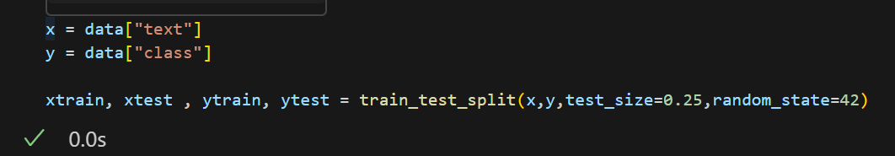
train_test_split() : Splits dataset into training set and testing set
Training set → 75% of data (used to train the model)
Testing set → 25% of data (used to evaluate the model)
xtrain and ytrain are like the practice material for the model: it learns patterns from them
xtest and ytest are like the final exam: we test the model on new data (xtest) and check if its answers match the real answers (ytest).

Slide 24
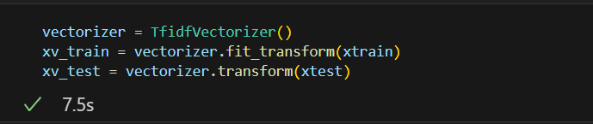
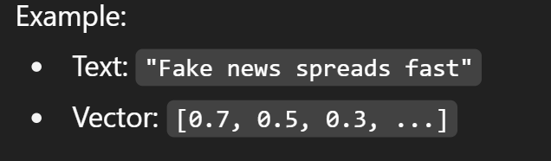
fit → learns the vocabulary (all words) from the training set.
transform → converts each news text into a vector of numbers (word weights).
vectorizer = TfidfVectorizer()
It assigns weights to words:
-High weight if the word is important in that document.
-Low weight if the word is common across many documents (like the, is, and).
xv_train = vectorizer.fit_transform(xtrain)
fit → learns the vocabulary (all words) from the training set.
transform → converts each news text into a vector of numbers (word weights).

Slide 25
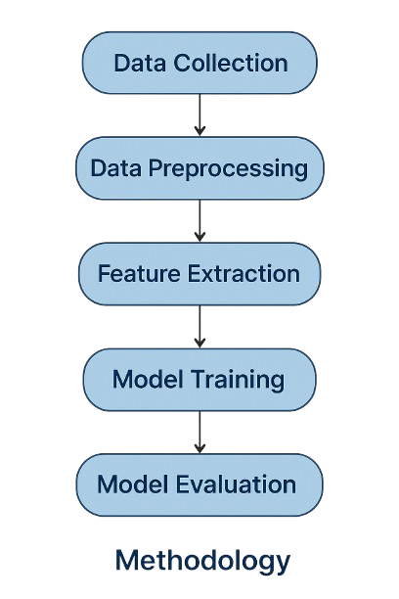
Methodology
methodology follows a systematic approach:
Data Collection
Data Preprocessing
Feature Extraction
Model Training
Model Evaluation
Data Collection
Primary dataset: Kaggle Fake and Real News Dataset
Additional data: Web scraping using BeautifulSoup for real-time headlines
Data stored in CSV format with attributes:
Title – News headline
Text – Full article text
Subject – Category (e.g., Politics, World News)
Date – Publication date

Slide 26
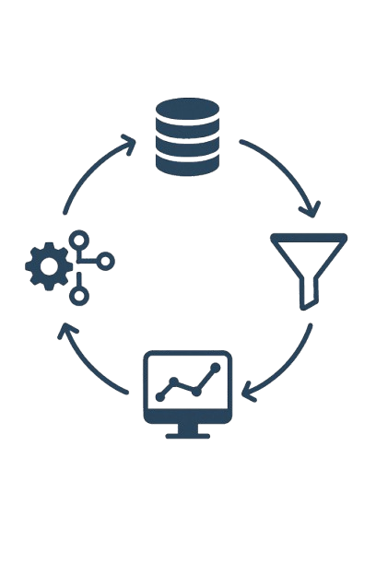
Methodology
Data Preprocessing
Cleaning: Remove unwanted characters, punctuation, numbers, HTML tags, and missing values
Normalization: Convert text to lowercase
Stopword Removal: Eliminate common words (e.g., the, is, and)
Feature Extraction
Text converted into numerical form using TF-IDF (Term Frequency – Inverse Document Frequency)
Assigns higher weight to unique words and lower weight to common words
Produces feature vectors that can be used by ML models

Slide 27

Methodology
Model Training & Testing :
Data split using train_test_split():
Training Set (75%) → Used to train the model
Testing Set (25%) → Used to evaluate model performance
Algorithms tested: Logistic Regression, Naive Bayes, Random Forest, etc.
Libraries used: scikit-learn, NLTK

Slide 28


